Slide 1













“Superstore Sales analyses”
Insights from Superstore Sales Dataset

Slide 2
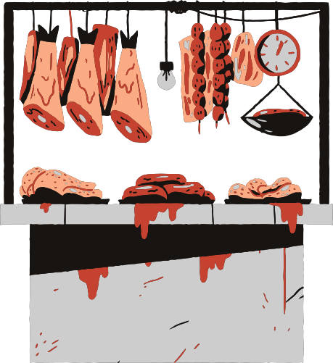
Introduction
Objective:
Analyze the sales data to gain insights into key sales performance, customer segmentation, and regional trends.
Key Areas of Focus:
Monthly Sales Trends: Peak months and patterns.
Product Performance: Top categories and sub-categories.
Shipping Impact: Effect of shipping methods on sales.
Regional Analysis: Highest and lowest sales by region.
Delivery Times: Average shipping times by category.
Customer Profitability: Most profitable segments.
Top Customers: Customers with highest sales.
Repeat Visits: Frequency of customer returns.
Low Sales Products: Products with low sales and repeat purchases.

Slide 3
Data Overview
Dataset Overview:
The dataset contains 9800 rows and 18 columns, representing sales orders over multiple years.
Columns in the Dataset:
Order Details:
Order ID: Unique identifier for each order.
Order Date: Date when the order was placed.
Ship Date: Date when the order was shipped.
Ship Mode: Shipping method selected
Customer Information:
Customer ID: Unique identifier for each customer.
Customer Name: Name of the customer.
Segment: Category of the customer
Region: Geographic area of the customer.
State: State of the customer's residence.
Product Information:
Product ID: Unique identifier for each product.
Category: Broad classification of products (e.g., Furniture).
Sub-Category: More specific classification within a category.
Product Name: Name of the specific product.
Sales: Revenue generated from the product.
Quantity: Number of items sold.
Discount: Price reduction applied to the sale.
Profit: Financial gain or loss from the sale.

Slide 4
Tools & Libraries Used
Pandas (import pandas as pd)
Used for data manipulation and analysis, especially for handling data in DataFrames.
Matplotlib (import matplotlib.pyplot as plt)
A plotting library used for creating static, animated, and interactive visualizations in Python.
Seaborn (import seaborn as sns)
A data visualization library built on top of Matplotlib, providing a high-level interface for drawing attractive and informative statistical graphics.

Slide 5


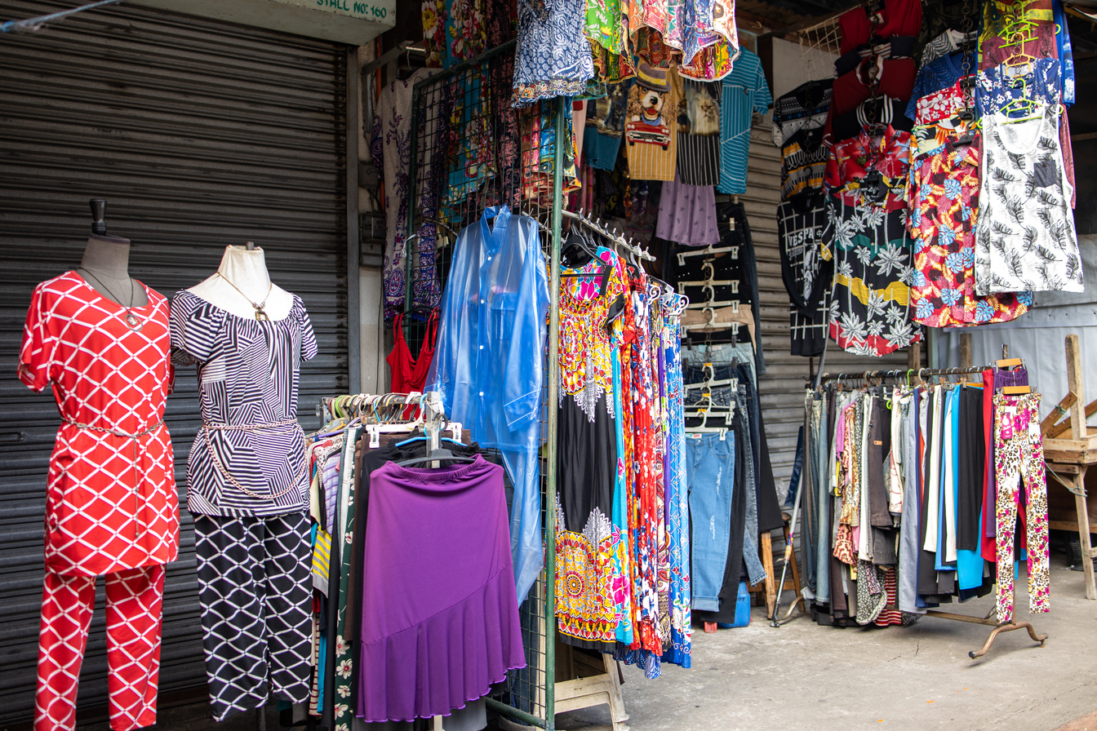
Methodology
Data Cleaning: Remove duplicates, handle missing values, and ensure data consistency.
Exploratory Data Analysis (EDA): Visualize data to identify trends, patterns, and outliers.
Key Insights Extraction: Focus on sales trends, product performance, and customer behavior.
Business Insights: Provide recommendations based on analysis findings.

Slide 6

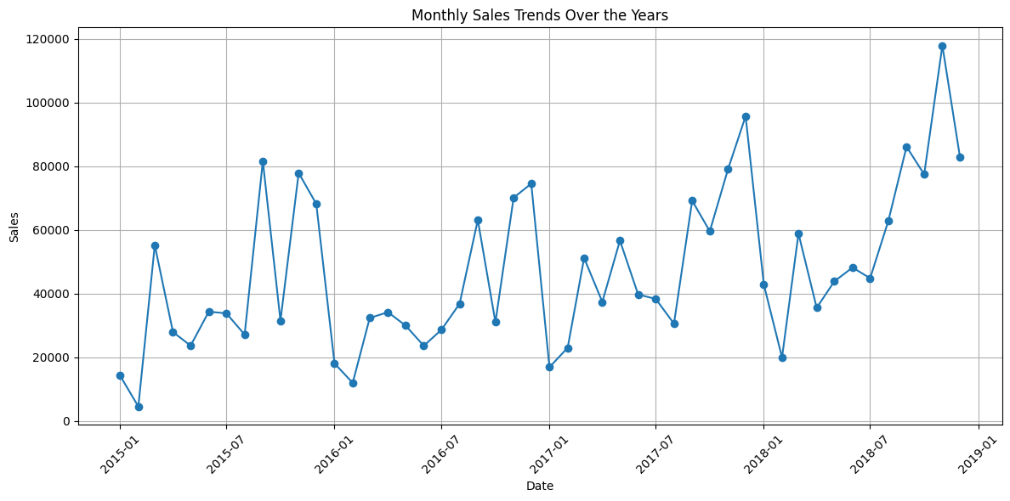
Monthly Sales Trends
1) What are the monthly sales trends over the years? Are there specific months with peak sales?

Slide 7


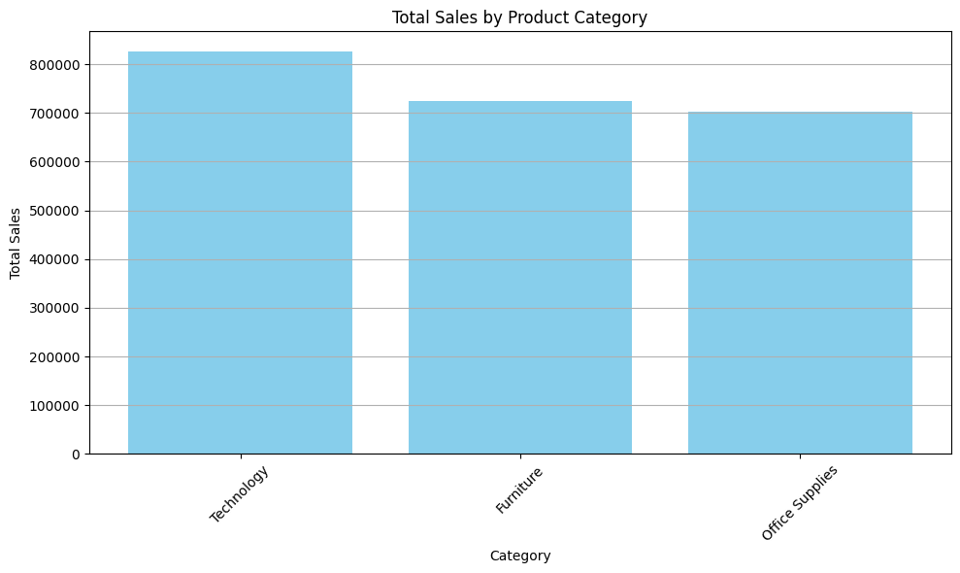
Product Category Performance
2) Which product categories generate the highest revenue? How do different sub-categories compare within those categories?

Slide 8
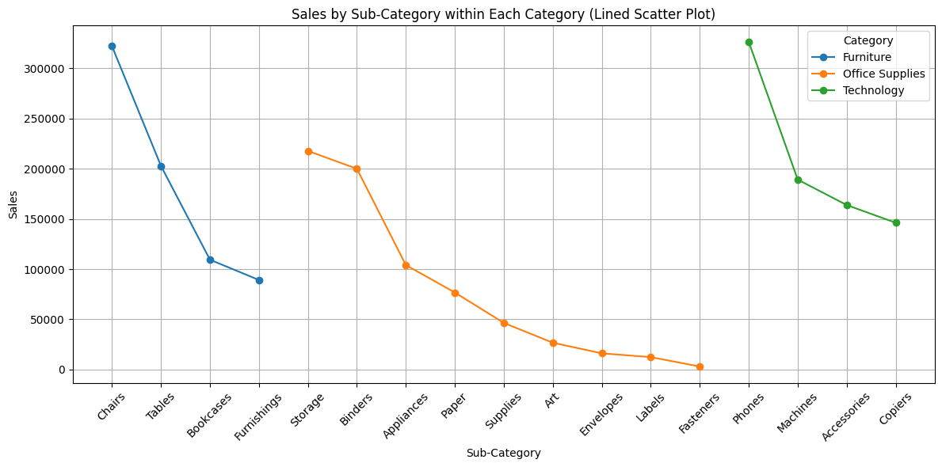
2) Which product categories generate the highest revenue? How do different sub-categories compare within those categories?

Slide 9
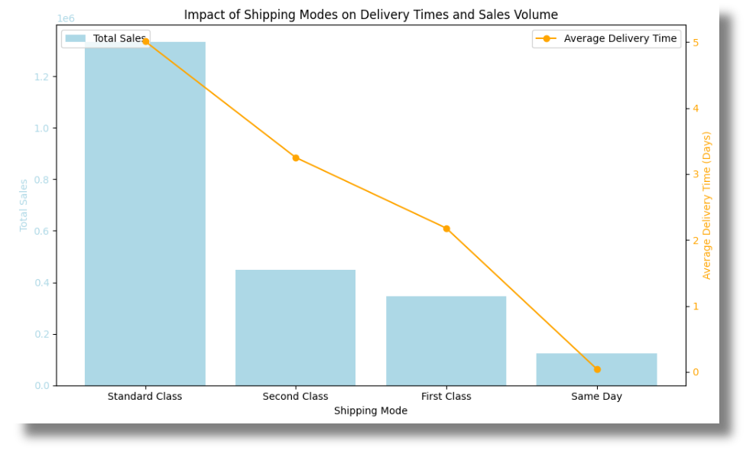
Impact of Shipping Modes
3) What is the impact of shipping modes (e.g., Second Class, First Class) on delivery times and sales volume?

Slide 10
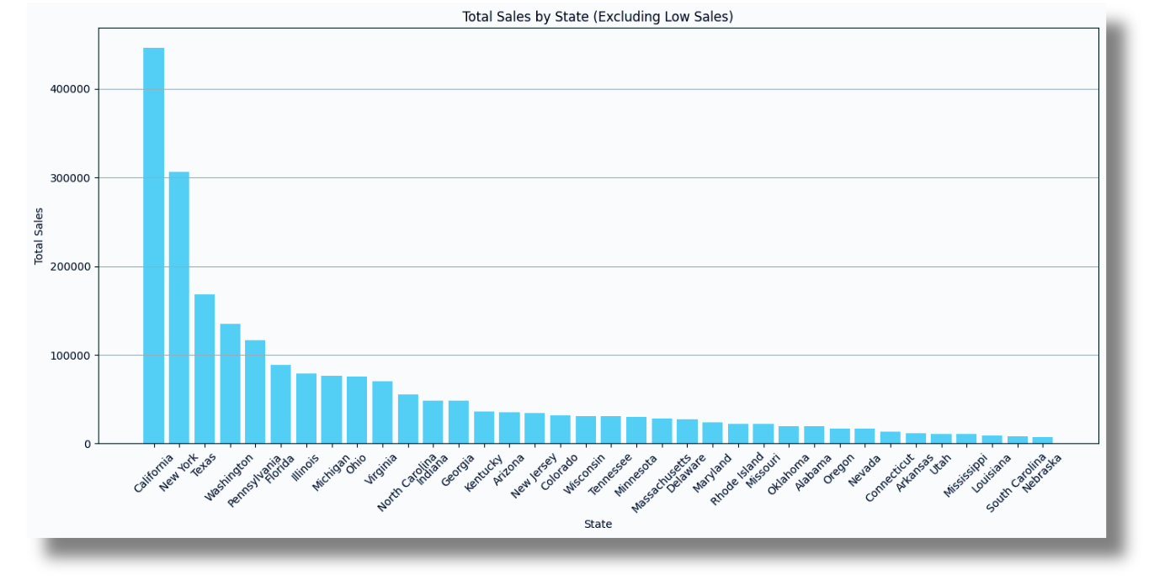
Regional Sales Analysis
4) Which states or regions contribute the most to total sales? Are there regions with notably low sales?

Slide 11
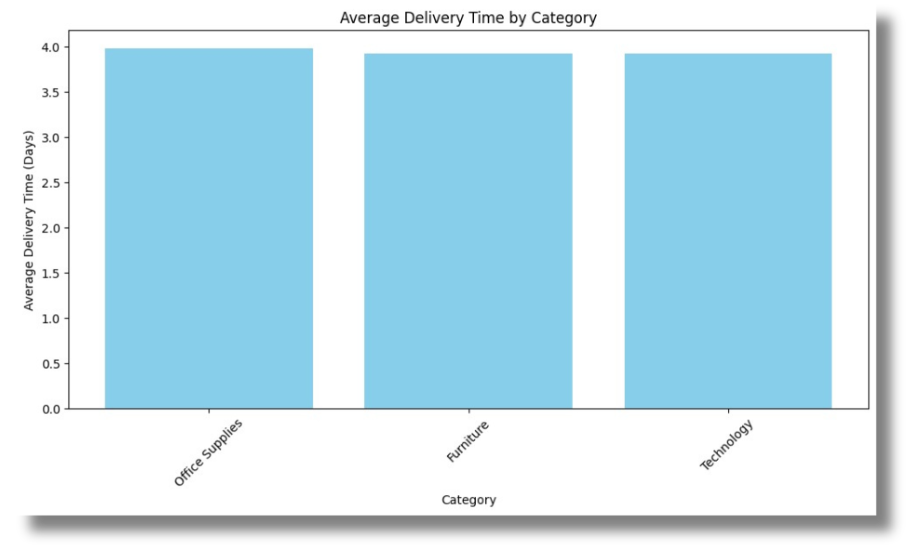
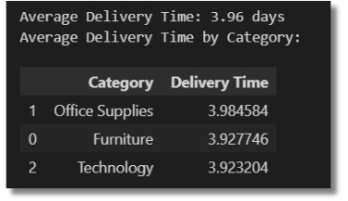
5) What is the average time taken for each category from order date to ship date?
Delivery Times Analysis

Slide 12
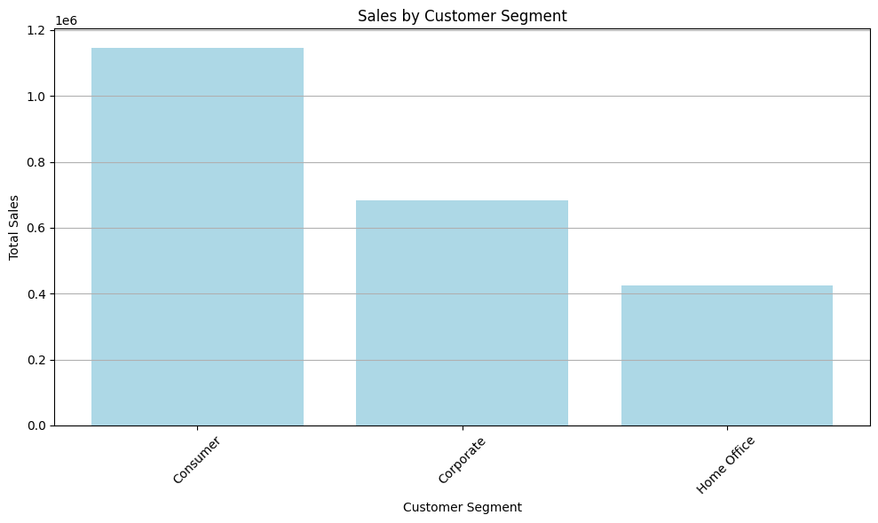
Customer Segment Profitability
6) How do sales differ across customer segments (Consumer, Corporate)? Which segment is the most profitable?

Slide 13

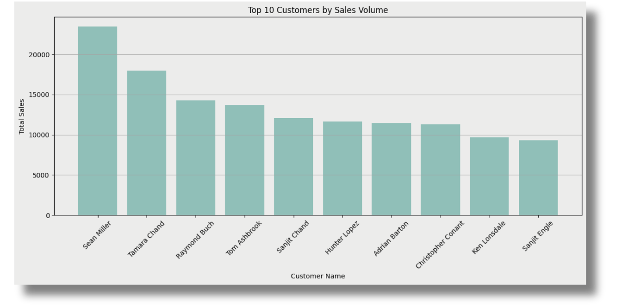
Top Customers
7) Who are the top customers by sales volume, Segment & Categories?

Slide 14
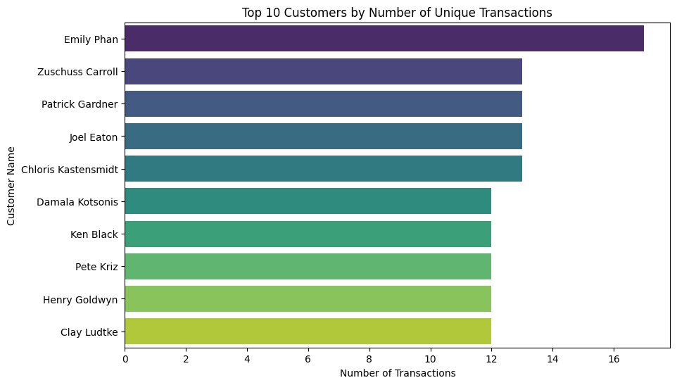
Customer Repeat Visits
8) Does we have customers repeated their visits?

Slide 15
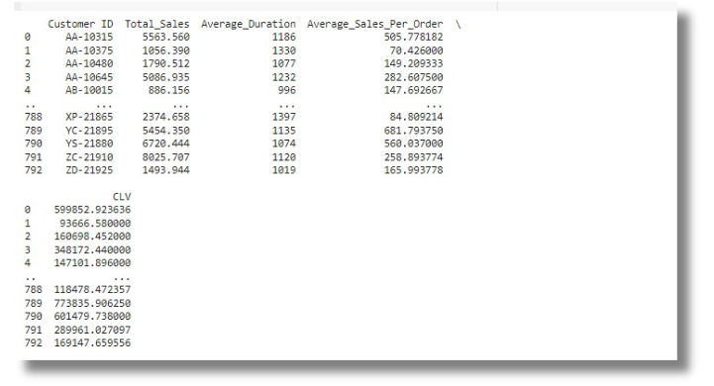
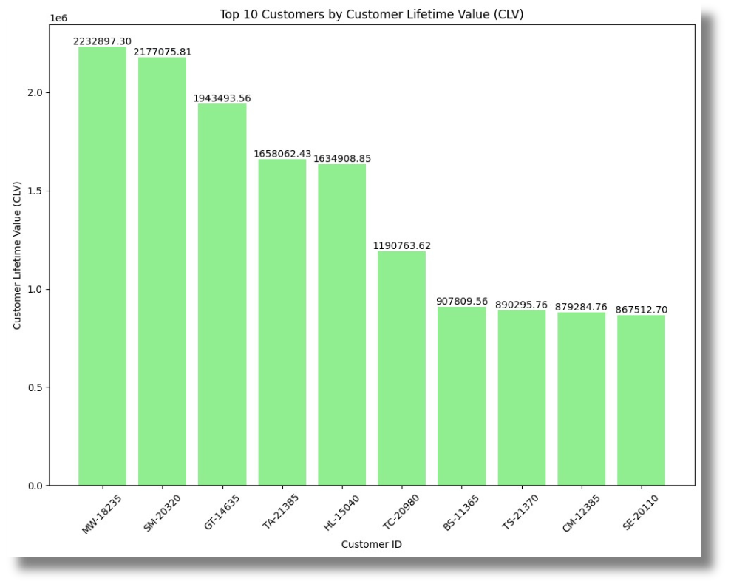
CLV “Customer Life Time Value”

Slide 16
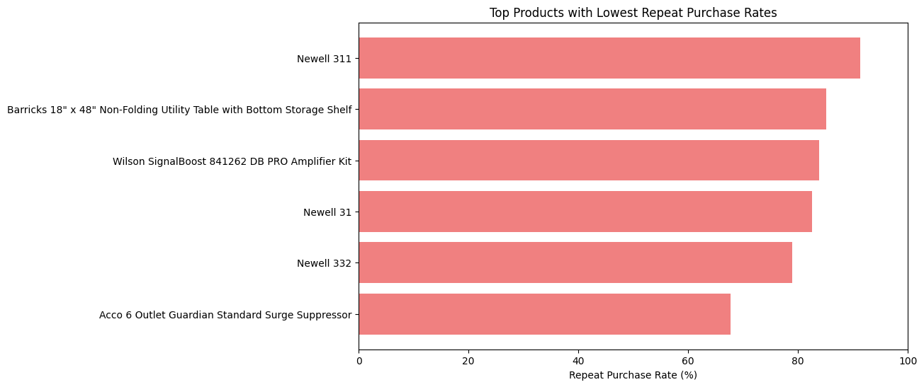
Lowest Repeated Purchased Products

Slide 17



Conclusion & Business Insights
Key Findings:
Monthly sales trends and peak sales months identified.
Product category performance and shipping mode impacts evaluated.
Regional sales contributions and delivery times analyzed.
Customer segment profitability and repeat visits assessed.
Insights & Recommendations:
Promote Top Categories: Focus on high-revenue products.
Improve Shipping: Optimize shipping methods for faster delivery.
Build Customer Loyalty: Encourage repeat purchases.
Review Low-Selling Products: Investigate and adjust low-performing items. Educational Content or Communication for the lowest product in sales.
Loyalty program for the highest customers shares in sales and the most customers that repeats their purchase.

Slide 18
Thank You for Your Attention!
Questions?
team:
Mohamed Said
Ahmed Shafek
Aya Mohamed
Ammar Mohamed
Dina Hany
Tayseer Ashraf

